Slide 1
COMPSCI X433.6 Introduction to Machine Learning using Python
Lecture 1: What is machine learning?
Lecture 2: Is the Gaussian probability density function boring?
Lecture 3: Principal Component Analysis
Lecture 4: Principal Component Analysis (more details)
Lecture 5: Linear Classifiers
Lecture 6: Decision Trees
Lecture 7: Data Mining
Lecture 8: Neural Networks
Lecture 9: Ensemble Classifiers / Context-Dependent Classification
Lecture 10: Team Project Presentations

Slide 2
Assignments and Quizzes
Team Project:
Your Choice!
Assignment 6:
Nonlinear Classifiers
Assignment 5:
Unsupervised Learning
Assignment 4:
Linear Classifiers
Assignment 3:
Principal Component Analysis
Assignment 2:
2D Histograms and Bayesian Classifiers
Assignment 1:
1D Histograms and Bayesian Classifiers

Slide 3
Lecture 1: What is machine learning?
What will you accomplish today ?
Glimpse of a real-life machine learning example from the banking industry
Excuse to introduce some jargon
Working definition: Oh… So, this is machine learning?
Working definition: Then what is Data Mining?
Machine Learning versus Other Things
Meet your first (ridiculously simple) classifier
An abstract look at the first classifier. How does it work?
Practical Motivation: An example from biometrics
Practical Motivation: An example from biometrics. Histograms.
Relevance of histograms for classification
“Regular” Histogram of teachers’ height
Normalized Histogram of teachers’ height
“Regular” Histogram of engineers’ height
Normalized Histogram of engineers’ height
More and more bins. Good or bad?
More and more bins. More and more samples.
Normalized Histograms to PDFs
Mean, median, standard deviation … Boring statistics
Mean, median, standard deviation … Boring statistics
The Cardinal Sinner
The Reformed
Histograms, PDFs and probabilities
Bayes Classifier (also, Theorem)
Bayes Classifier (also, Theorem)
Multi-class, multidimensional generalizations
Step-by-Step: Pseudocode for computing the histogram
Step-by-Step: Homework Assignment 1 (1D)
Step-by-Step: Homework Assignment 1 (1D)
Histogram & PDF Q & A

Slide 4
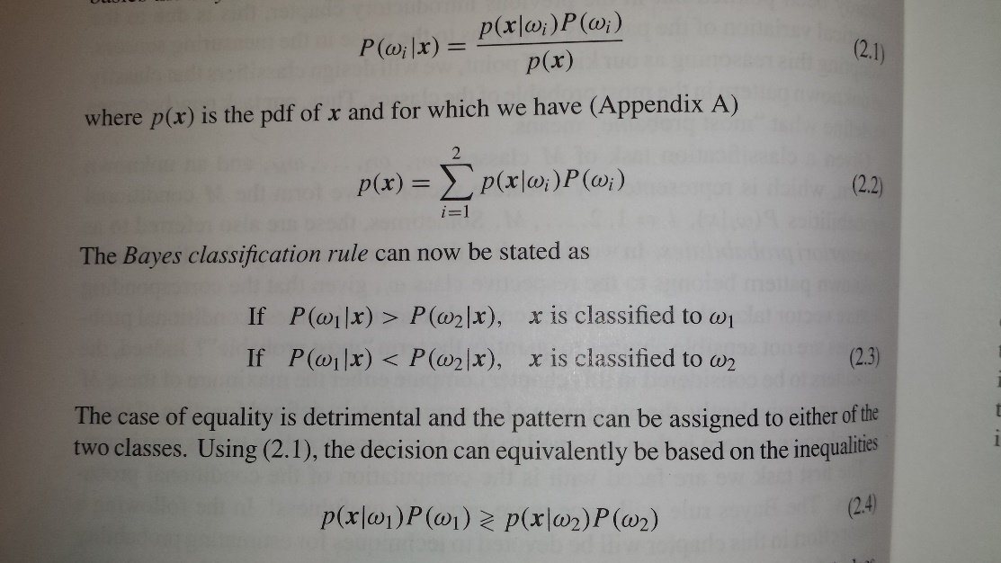
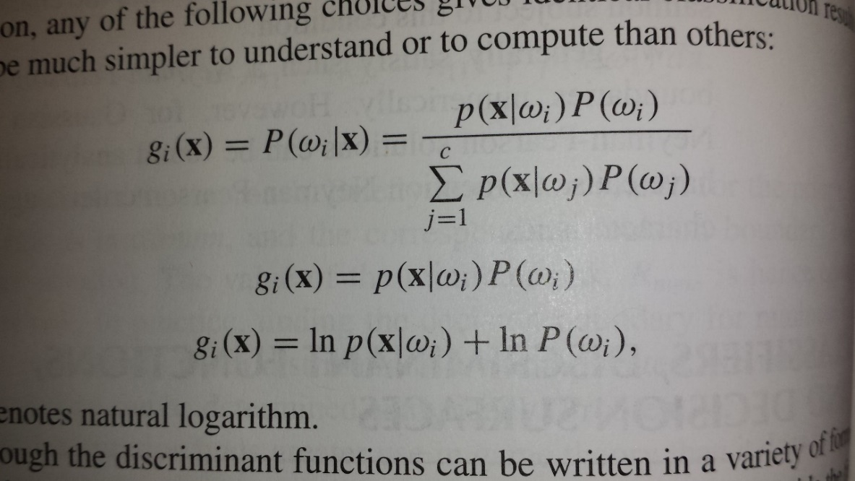
What will you accomplish today ?
Right after your very first class, go home with the knowledge to program two classifiers!
Know how to build multidimensional, multiclass classifiers! Yes. That is a stretch, but is essentially correct.
Look at this slide again after Lecture 1

Slide 5
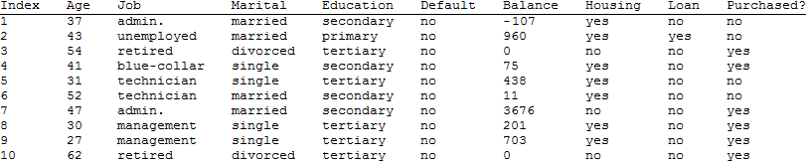
Glimpse of a real-life machine learning example from the banking industry
The machine learning problem
Alice works in a bank that actively sells loans.
She needs to meet her daily sales quota.
She has basic information on Bob, including his phone number.
She is worried that she will have to spend 30 minutes talking to Bob with no guarantee of closing any deal.
Should she call Bob, or move on to the next potential customer?
A possible solution
Look at records of similar individuals and check if a successful sale was made.
A look at some of the data (partial)
S. Moro, R. Laureano and P. Cortez. Using Data Mining for Bank Direct Marketing: An Application of the CRISP-DM Methodology. In P. Novais et al. (Eds.), Proceedings of the European Simulation and Modelling Conference - ESM'2011, pp. 117-121, Guimarães, Portugal, October, 2011. EUROSIS.
A new candidate's financial variables must be compared against entries in a huge database and a prediction must be computed.

Slide 6
Excuse to introduce some jargon
Training Set
Ordinal
Nominal
Nominal
Nominal
Nominal
Ordinal
Nominal
Nominal
Class label
Features
Feature Vector
also called pattern

Slide 7

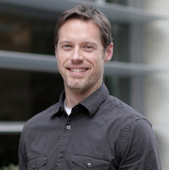
Working definition: Oh… So, this is machine learning?
Classifier Usage
Classifier
Feature Vector
Output Class Label
Classifier Design
Learning Algorithm
Training set
Classifier
(Feature Vectors+
Known Class Labels)
Eric Graham, you have been honored with the Eagle Eye Award for spotting an error or omission on this slide.
Congratulations and thank you for your help in improving this presentation.
CLICK TO DISMISS
This is also known as supervised learning (learning from examples)
*These definitions cover most, but not all of machine learning

Slide 8
Working definition: Then what is Data Mining?
Classifier Usage
Classifier
Groupings or
Clusters of
patterns
Input patterns
This is also known as unsupervised learning (learning without examples)
*Data Mining is part of machine learning

Slide 9
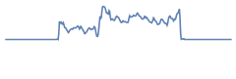
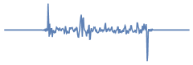

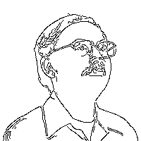
Machine Learning versus Other Things
DSP
(Digital Signal Processing)
DIP
(Digital Image Processing)

Slide 10
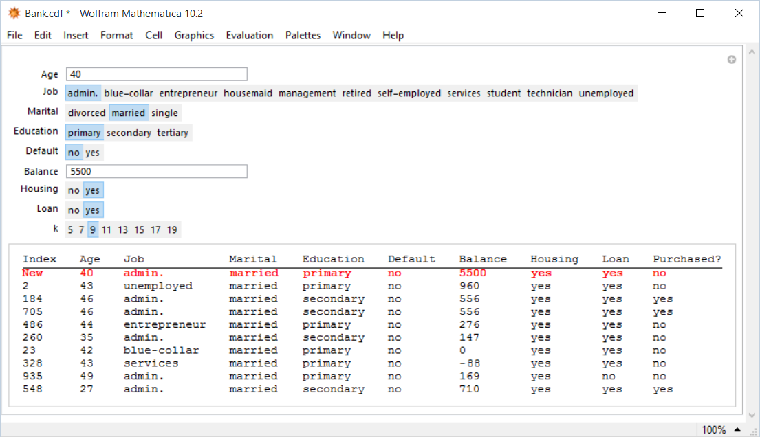
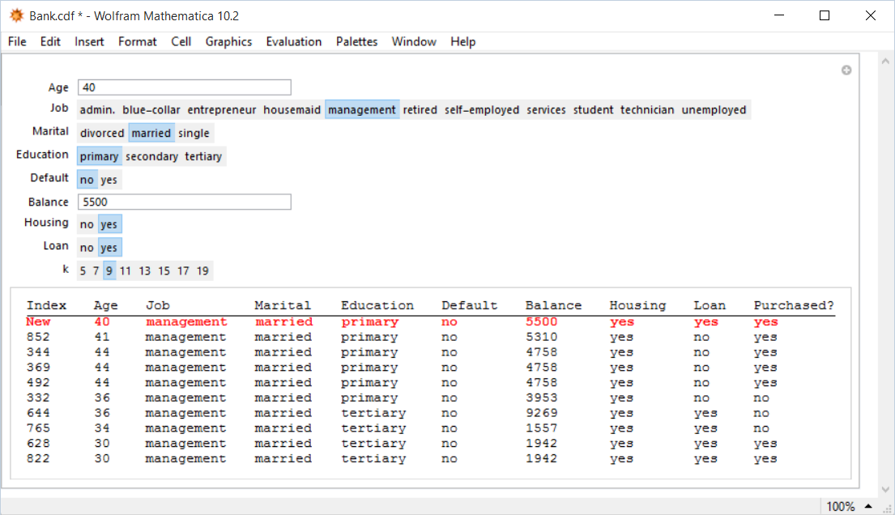
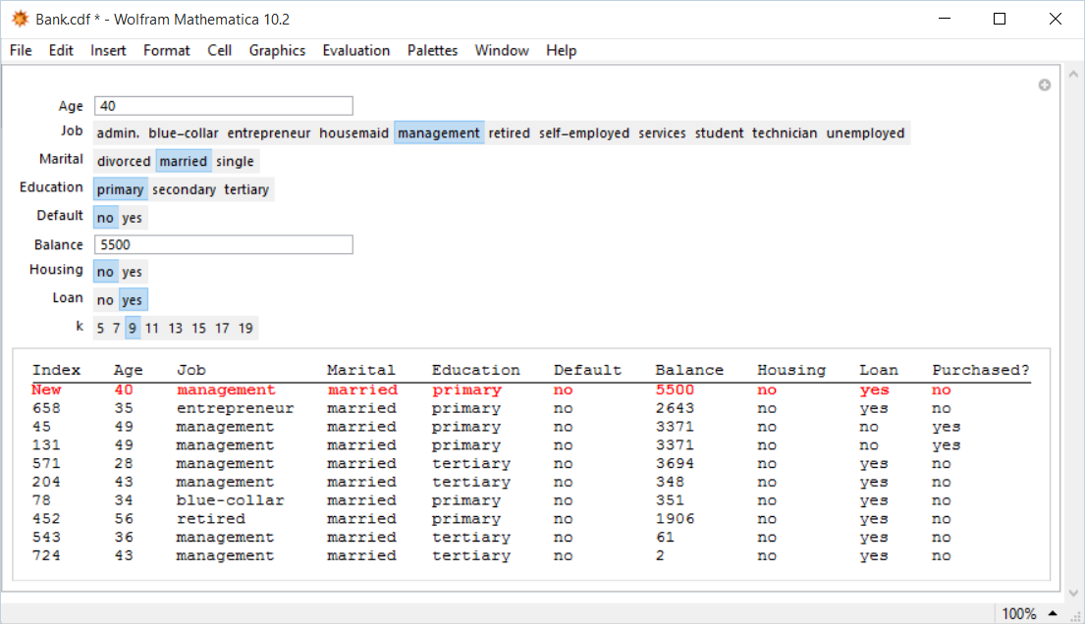
Meet your first (ridiculously simple) classifier
Query
Prediction
The algorithm retrieves feature vectors similar to the query vector

Slide 11
An abstract look at the first classifier. How does it work?
User inputs a correctly formed feature vector. [User “queries.”]
The algorithm searches the training set and retrieves the subset of feature vectors similar to the input feature vector.
Similar: Falling within a small radius r of the input feature vector.
The algorithm assigns the class label of the input feature vector to the commonest of the class labels associated with the feature vectors of the subset.
We do not need to wait for a query and then start searching for similar feature vectors! We can be prepared, i.e. break up the entire input feature vector space into small regions and, within each region, store the number of feature vectors by class.
Histograms!

Slide 12
Practical Motivation: An example from biometrics
Empirical observation: Men are taller than women
Question: Can we design a classifier to “recognize” the gender given the height?
What do we need to get started?
How do we proceed to build the classifier?
How do we use the classifier?
Would such a classifier be accurate? What must be done to increase the accuracy?
Note: This is not merely a textbook exercise. Biometric systems used in security and authentication actually use the concepts described here.

Slide 13
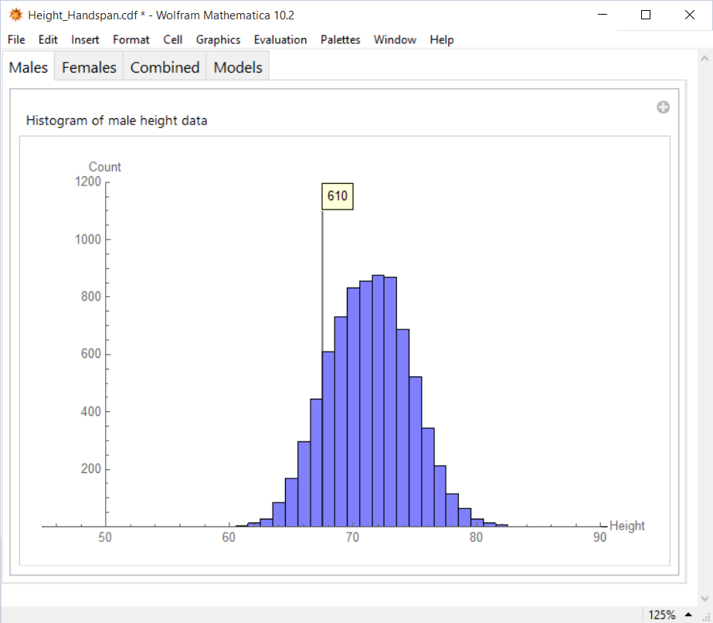
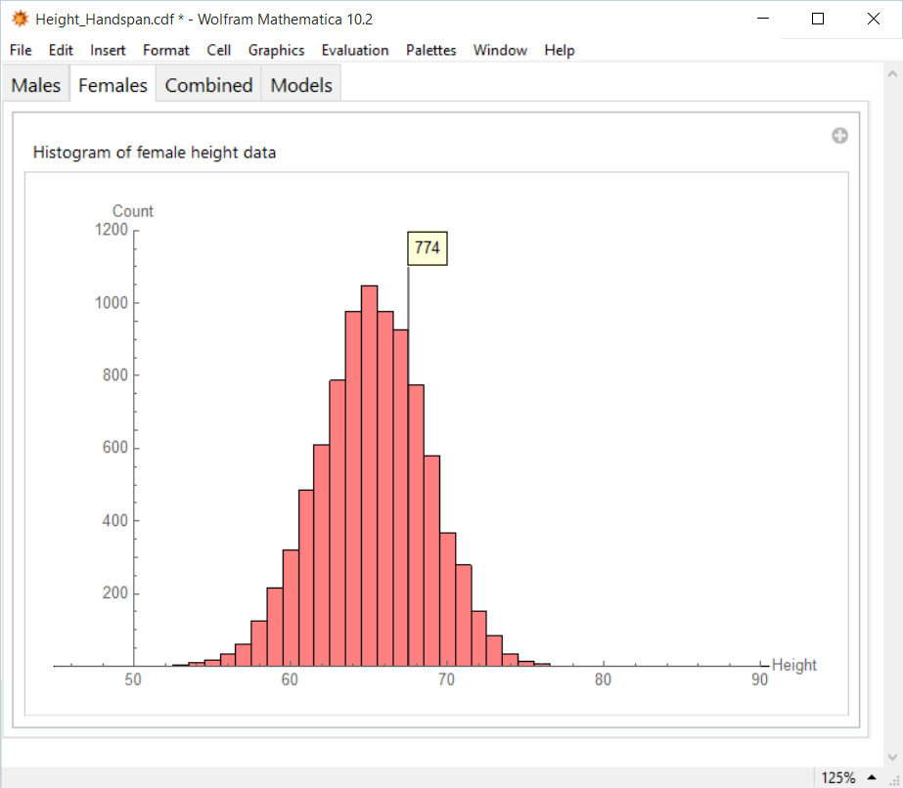
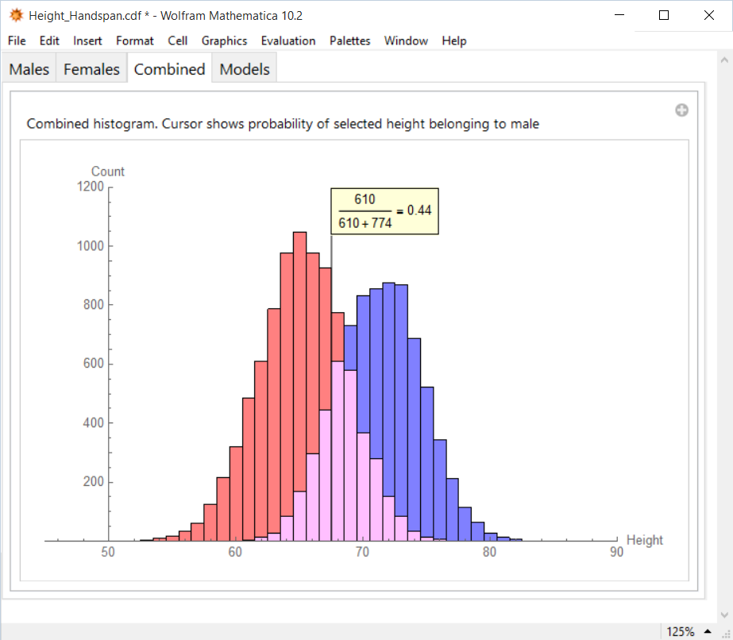
Practical Motivation: An example from biometrics. Histograms.
What is the probability of a 67 inch person being male?
How many 67 inch males?
How many 67 inch females?
*To be rigorous, this question should read like “What is the count of females having height between 65 and 68 inches?” Same goes for other questions here.

Slide 14
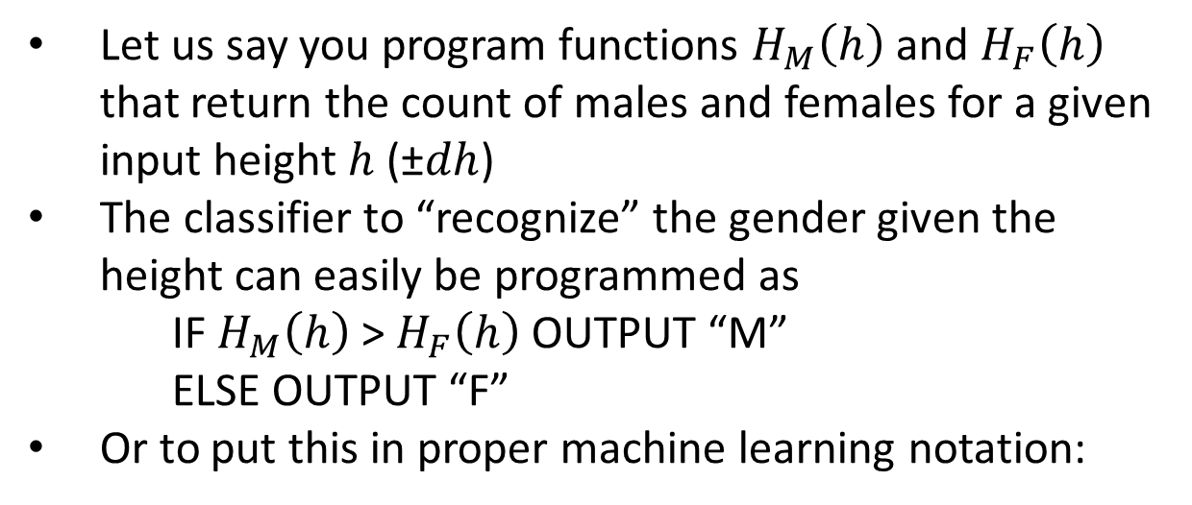
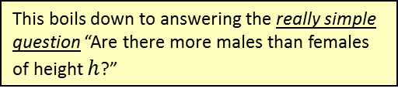
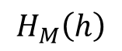
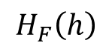
Relevance of histograms for classification
Effectively we have implemented
Search and retrieval of training feature vectors similar to the input feature vector
Assignment of class to the commonest of the class labels.
M
>
<
F

Slide 15
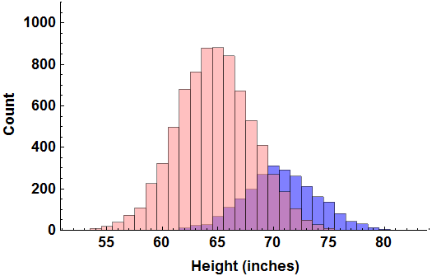
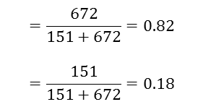
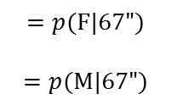
“Regular” Histogram of teachers’ height
672 Female teachers
with height 67”
151 Male teachers
with height 67”
If we are asked to guess the gender of a new 67” teacher, we would refer to the above regular histogram and decide the gender based on the following two computed probabilities:
Probability of being female, given h=67”
Probability of being male, given h=67”

Slide 16
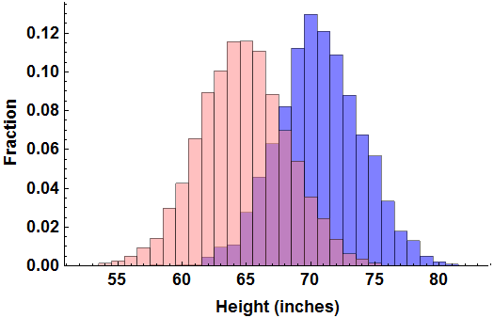
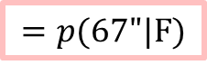
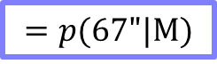

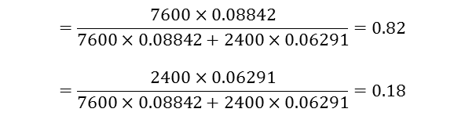
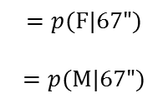

Normalized Histogram of teachers’ height
0.08842 Fraction of female teachers with height 67”
0.06291 Fraction of male teachers with height 67”
7600 Female
teachers
2400 Male
teachers
If we are asked to guess the gender of a new 67” teacher, we would refer to the above normalized histogram AND the additional information on prevalence and decide the gender based on the following two computed probabilities:
Probability of being female, given h=67”
Probability of being male, given h=67”

Slide 17
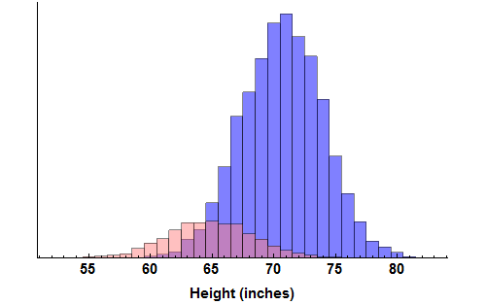
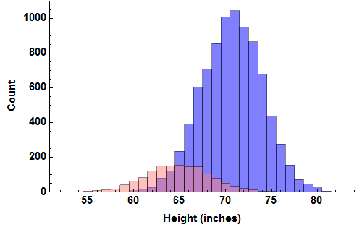
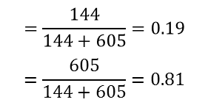
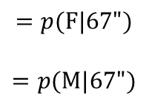
“Regular” Histogram of engineers’ height
144 Female engineers
with height 67”
605 Male engineers
with height 67”
If we are asked to guess the gender of a new 67” engineer, we would refer to the above regular histogram and compare the two probabilities:
Probability of being female, given h=67”
Probability of being male, given h=67”

Slide 18
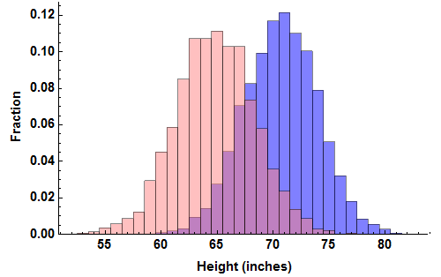
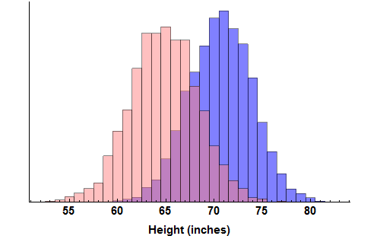
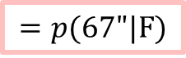
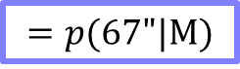

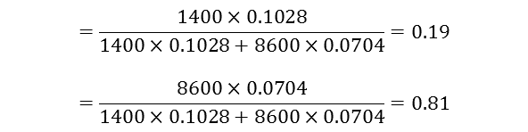
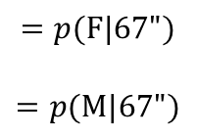
Normalized Histogram of engineers’ height
0.1028 Fraction of female engineers with height 67”
0.0704 Fraction of male engineers with height 67”
1400 Female
engineers
8600 Male
engineers
If we are asked to guess the gender of a new 67” engineer, we would refer to the above normalized histogram AND the additional information on prevalence and compare the two probabilities:
Probability of being female, given h=67”
Probability of being male, given h=67”

Slide 19
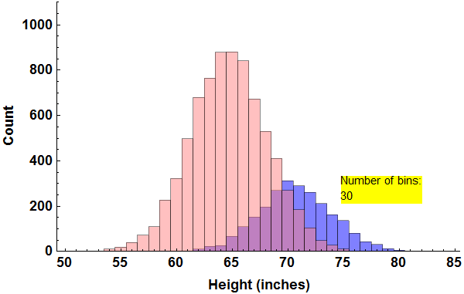
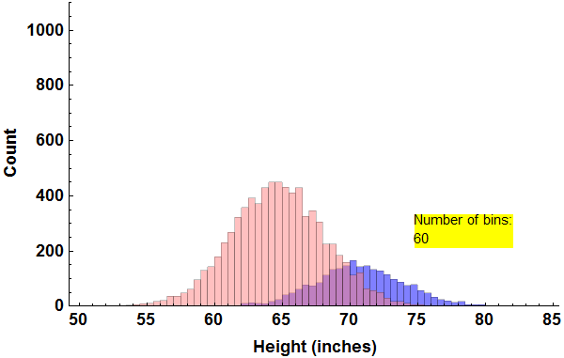
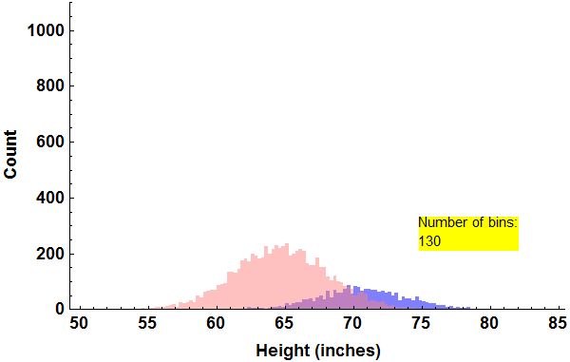
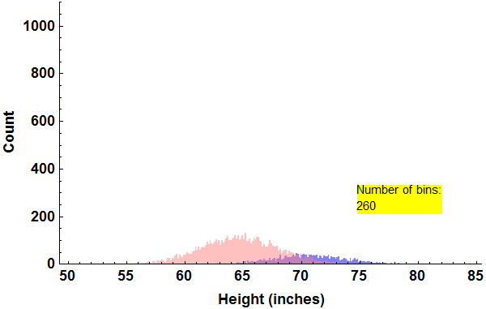
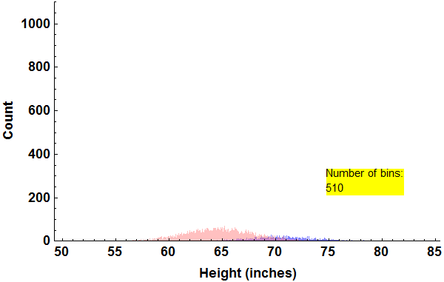
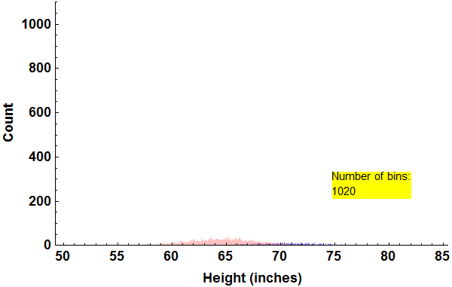
More and more bins. Good or bad?

Slide 20
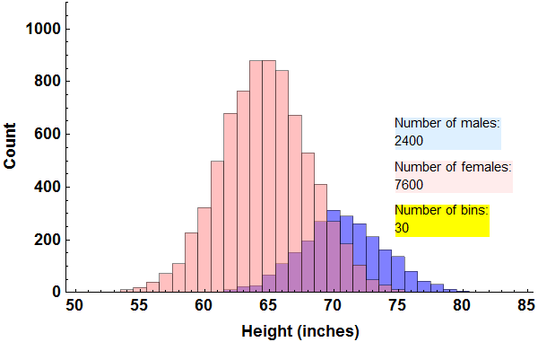
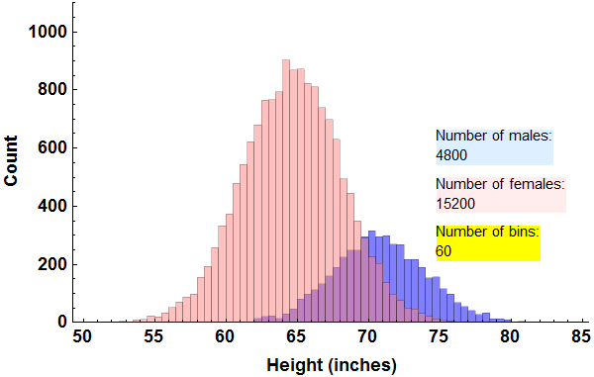
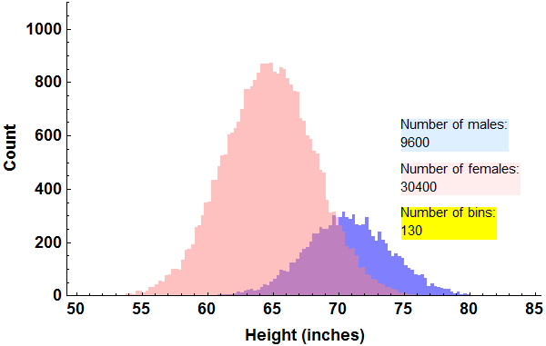



More and more bins. More and more samples.

Slide 21
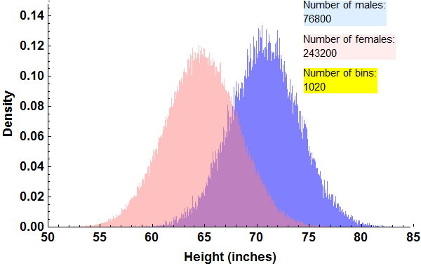
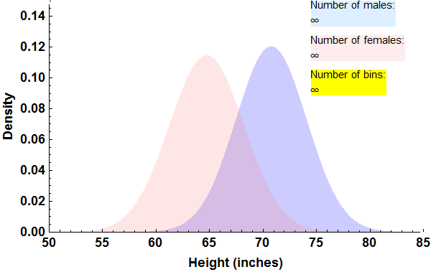
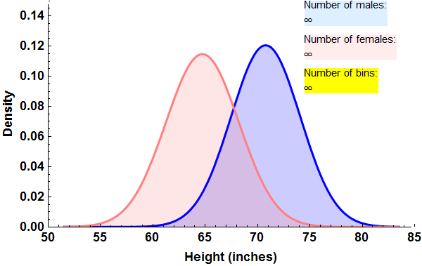
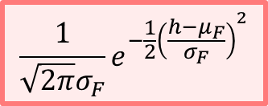
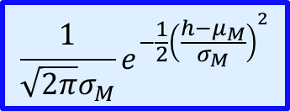
Normalized Histograms to PDFs

Slide 22
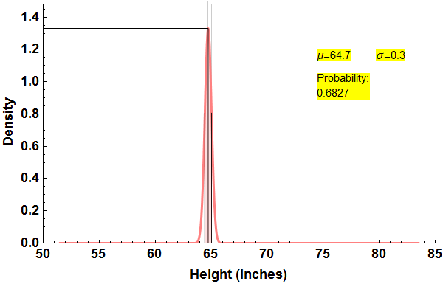





Mean, median, standard deviation … Boring statistics

Slide 23










Mean, median, standard deviation … Boring statistics

Slide 24

The Cardinal Sinner
The probability of “getting 60 inches is 0.045”
Never say that

Slide 25





The Reformed
Width= 0 inch
Width= ½ inch
Width= 1 inch
2.28% of samples are inside the shaded strip
4.57% of samples are inside the shaded strip

Slide 26

Histograms, PDFs and probabilities
The presence of the denominator turns these quantities into probabilities.

Slide 27



Bayes Classifier (also, Theorem)
What is the overall probability of getting M?
What is the overall probability of getting F?
A priori probability
Class conditional probability
Posterior probability

Slide 28

Bayes Classifier (also, Theorem)
A priori probability
Class conditional probability
Posterior probability

Slide 29




Multi-class, multidimensional generalizations
Take a look at Slide 1 again!

Slide 30


Step-by-Step: Pseudocode for computing the histogram

Slide 31

Step-by-Step: Homework Assignment 1 (1D) (unofficial)
Assignment Instructions
The data set that you need is in one of the sheets of the Excel file Assignment_1_1D_Data_and_Template.xlsx. The other three sheets contain shaded cells meant to be filled in by you. Examine the sheets carefully and understand what must be computed or described.
Construct separate histograms for male and female heights using 32 bins. Do not use a built in histogram program.
Based on the histograms, compute the probability of being female of individuals with heights 55, 60, 65, 70, 75 and 80 inches
Find the parameters of Gaussian models for the 2 PDFs to describe the data. You may use built in functions to compute the model parameters.
Use the Bayesian Formula with the model parameters found above to re-compute the probability of being female of individuals with heights 55, 60, 65, 70, 75 and 80 inches
Repeat steps 2 through 5 using just the first 50 height entries in the data file. Now what are your observations regarding histogram classifiers and Bayesian classifiers?

Slide 32



Step-by-Step: Homework Assignment 1 (1D)
M
>
<
F
*Sample standard deviation, with N-1 in the denominator.

Slide 33

Histogram & PDF Q & A

Slide 34
Lecture 2: Is the Gaussian probability density function boring?
Recap Histogram & Bayes Classifier (MAKE SURE YOU FULLY UNDERSTAND THIS)
Histogram & Bayes Classifier (TWO DIMENSIONS)
Histogram & Bayes Classifier (TWO DIMENSIONS)
Histogram & Bayes Classifier (TWO DIMENSIONS)
Two Dimensional Data overlaid on Contour Plots of the PDFs
Two Dimensional Gaussian Intuition
Two Dimensional Gaussian Intuition (more general)
What does an “outlier” mean?
How do I specify a 1D point cloud?
How do I specify a 2D point cloud?
How do I specify a 2D point cloud?
Covariance (a.k.a covariance matrix)
Covariance (a.k.a covariance matrix)
Bayes Classifier (d DIMENSIONS)
Covariance Interpretation Practice
Step-by-step: PDF of the binormal distribution
Calculation of the PDF of the binormal distribution
Calculation of the PDF of the multinormal distribution
Assignment 2 (unofficial)
Step-by-step: How can I build 2D Histograms?
Step-by-step: How can I build a 2D Bayesian Classifier?
Wake Up!
Wake Up! (Solution)

Slide 35















Recap Histogram & Bayes Classifier (MAKE SURE YOU FULLY UNDERSTAND THIS)
Bayes theorem can be used to answer the question “Given that an individual’s height is $x$, what is the probability that the individual is female?”
The prevalence terms $P\left(F\right)$ and $P(M)$ are easily found from counts of the total number of F and M in the training set
The class conditional terms $p\left(x|F\right)$and $p\left(x|M\right)$can be found using normalized histograms constructed from training data. Or, if the distributions happen to be normal (Gaussian), $p\left(x|F\right)$and $p\left(x|M\right)$are found using formulas containing means and standard deviations of samples from the classes taken separately
Given F what is the probability of getting $x$ ?
What is the prevalence of F?
$$P(F)$$
$$p\left(x|F\right)$$
$$P_{F}$$
$$p_{F}\left(x\right)$$
+
$$P(F)$$
$$p\left(x|F\right)$$
+
$$p\left(x|M\right)$$
$$P_{F}$$
$$p_{F}\left(x\right)$$
$$P_{M}$$
$$p_{M}\left(x\right)$$
$$P(M)$$
What is the prevalence of M?
Given M what is the probability of getting $x$ ?

Slide 36


Histogram & Bayes Classifier (TWO DIMENSIONS)
In an attempt to obtain more accurate classification, we will consider an additional feature, handspan denoted by $s$. Again we can build a simple classifier to determine gender from height by constructing “male and female histograms” separately i.e. $ℋ_{M}\left(h,s\right)$ and $ℋ_{F}\left(h,s\right)$ this time in a higher dimension
Query: Given an individual’s height $x$ and handspan $y$ we can easily “run the classifier” shown below to determine the likely gender
M
$$ℋ_{M}\left(x,y\right)$$
>
$$ℋ_{F}\left(x,y\right)$$
<
F
Think about the question: What formulas can we use to approximate the histograms?

Slide 37



Histogram & Bayes Classifier (TWO DIMENSIONS)
In order to classify using two features (height and handspan) we need to use the following formula which contains a generalization of the normal PDFs
Note that $x$is now a vector specifying an individual’s height and handspan. The entities mean and standard deviation (e.g. $μ_{F}$ and $σ_{F}$) are now replaced with the mean vector and the covariance matrix (e.g. $μ_{F}$ and $Σ_{F}$)
The mean vectors and the covariance matrices contain information about the shape of the 3D histograms shown on the previous slide
M
$$N_{F}\left(\frac{1}{2π{ \left|Σ_{F}\right|}^{\frac{1}{2}}}e^{−\frac{1}{2}\left(x−μ_{F}\right) {Σ_{F}}^{−1}{\left(x−μ_{F}\right)}^{T}}\right)$$
$$N_{M}\left(\frac{1}{2π{ \left|Σ_{M}\right|}^{\frac{1}{2}}}e^{−\frac{1}{2}\left(x−μ_{M}\right) {Σ_{M}}^{−1}{\left(x−μ_{M}\right)}^{T}}\right)$$
>
<
F

Slide 38

Histogram & Bayes Classifier (TWO DIMENSIONS)

Slide 39


Two Dimensional Data overlaid on Contour Plots of the PDFs
Males
Females
Think about the question: How do you specify a 2D point cloud?

Slide 40



Two Dimensional Gaussian Intuition
Errors are independent of orientation.
Errors in x are independent of errors in y.
Large errors are less probable

Slide 41



Two Dimensional Gaussian Intuition (more general)
Errors are dependent on orientation.
Errors in x are dependent on errors in y.
Large errors are less probable

Slide 42

What does an “outlier” mean?
Not an outlier
Is an outlier

Slide 43


How do I specify a 1D point cloud?
Assuming that the points are normally distributed …

Slide 44


How do I specify a 2D point cloud?
Assuming that the points are bi-normally distributed …

Slide 45


How do I specify a 2D point cloud?
The standard deviations alone are NOT sufficiently descriptive.

Slide 46

Covariance (a.k.a covariance matrix)
Features
Feature Vectors
N=6
d=7
Are these two features related?
More specifically, are they linearly correlated?
Still more specifically, what is the amount of linear correlation between these two features?

Slide 47



Covariance (a.k.a covariance matrix)
Mean Vector
Gives some sense of “Amount of linear correlation”
$$\sum_{k=1}^{6}{\left(x_{k3}−{\overline{x}}_{3}\right)\left(x_{k6}−{\overline{x}}_{6}\right) }$$
Definition of ij-term in covariance matrix
$$c_{ij}=\frac{1}{N−1}\sum_{k=1}^{N}{\left(x_{ki}−{\overline{x}}_{i}\right) \left(x_{kj}−{\overline{x}}_{j}\right) }$$

Slide 48
Bayes Classifier (d DIMENSIONS)
In order to classify using d features (height, handspan, voice frequency, … ) we need to use the following formula which contains a generalization of the normal PDFs
Try approximating (using a common covariance matrix $Σ$):
$$N_{M}\left(\frac{1}{{\left(2π\right)}^{\frac{d}{2}}{\left|Σ_{M}\right|}^{\frac{1}{2}}}e^{−\frac{1}{2}\left(x−μ_{M}\right) {Σ_{M}}^{−1}{\left(x−μ_{M}\right)}^{T}}\right)$$
M
$$N_{F}\left(\frac{1}{{\left(2π\right)}^{\frac{d}{2}}{\left|Σ_{F}\right|}^{\frac{1}{2}}}e^{−\frac{1}{2}\left(x−μ_{F}\right) {Σ_{F}}^{−1}{\left(x−μ_{F}\right)}^{T}}\right)$$
>
<
F
$$\left\{1×d\right\}$$
$$\left\{d×d\right\}$$
$$\left\{d×1\right\}$$
Turns out to be a scalar, real number
M
$$N_{M} 𝒩\left(x|μ_{M},Σ_{M}\right)$$
>
$$N_{F} 𝒩\left(x|μ_{F},Σ_{F}\right)$$
<
F
$$N_{M}\left(−\frac{1}{2}\left(x−μ_{M}\right) Σ^{−1}{\left(x−μ_{M}\right)}^{T}\right)$$
M
$$N_{F}\left(−\frac{1}{2}\left(x−μ_{F}\right)Σ^{−1}{\left(x−μ_{F}\right)}^{T}\right)$$
>
<
F

Slide 49




Covariance Interpretation Practice

Slide 50

Step-by-step: PDF of the binormal distribution
It is highly recommended that you define a general function to compute the PDF of a Gaussian distribution in multiple dimensions. At least once, calculate an example by hand (the calculation of the inverse is optional) and track all the intermediate results

Slide 51



Calculation of the PDF of the binormal distribution
The PDF of a Gaussian distribution in two dimensions is given by
where $x$ and $μ$ are two dimensional vectors and $Σ$ is a $2×2$ matrix.
The expression for the PDF can be written in a form more suitable for computation by writing out the variables and parameters explicitly:
$$x=\left\{x_{1},x_{2}\right\} \text{and} μ=\left\{μ_{1},μ_{2}\right\}$$
$$Σ=\left(\begin{matrix}c_{11} & c_{12} \\ c_{21} & c_{22}\end{matrix}\right)$$
Then, the determinant in the expression turns out to be $\left|Σ\right|=c_{11}c_{22}−c_{12}c_{21}$
The argument of the exponential turns out to be
It is highly recommended that you define a general function to compute the PDF of a Gaussian distribution in multiple dimensions.

Slide 52









Calculation of the PDF of the multinormal distribution
The inverse ($d×d$) of the covariance matrix for a given numerical dataset ($N×d$) can be found using callable functions available in most numerical software development platforms.
For the simple case of a $2×2$ covariance matrix $\left[\begin{matrix}c_{11} & c_{12} \\ c_{21} & c_{22}\end{matrix}\right]$, the inverse is readily calculated as $\left[\begin{matrix}c_{22} & −c_{12} \\ {−c}_{21} & c_{11}\end{matrix}\right]/\left(c_{11}c_{22}−c_{12}c_{21}\right)$.
Click on any box inside this formula to get a description. Click on the same box again to dismiss.
The covariance matrix ($d×d$) for a given numerical dataset ($N×d$) can be found using callable functions available in most numerical software development platforms.
$$\frac{1}{{\left(2π\right)}^{\frac{d}{2}}\sqrt{\left|Σ\right|}}e^{−\frac{1}{2} \left(x−μ\right) Σ^{−1}{\left(x−μ\right)}^{T}}$$
For a given feature vector $x$the scalar quantity $\left(x−μ\right) Σ^{−1}{\left(x−μ\right)}^{T}$ can be found using matrix multiplication functions available in most numerical software development platforms.
Alternatively, by defining the $d$- dimensional vector $z=x−μ$ and the matrix ${A=Σ}^{−1}$, the equivalent scalar quantity $z A z^{T}$ is easily calculated as $\sum_{j=1}^{d}{\sum_{k=1}^{d}{z_{j}z_{k}a_{jk}}}$
The determinant of the covariance matrix can be found using callable functions available in most numerical software development platforms.
For the simple case of a $2×2$ covariance matrix $\left[\begin{matrix}c_{11} & c_{12} \\ c_{21} & c_{22}\end{matrix}\right]$, the determinant is readily calculated as $c_{11}c_{22}−c_{12}c_{21}$.
Next Slide

Slide 53
Assignment 2 (unofficial)
The data set that you need is in one of the sheets of the Excel file Assignment_2_Data_and_Template.xlsx. The other sheets contain shaded cells meant to be filled in by you. Examine the sheets carefully and understand what must be computed or described.
Construct separate 2D histograms for male and female heights. You decide on the number of bins to use, making sure there is sufficient resolution and bin-filling. Do not use a built-in histogram program.
Find the parameters of two 2D Gaussian models for the 2 PDFs to describe the data. You may use built-in functions to compute these parameters
Based on the histograms and Gaussian models, compute the likely gender (given as the probability of being female) of individuals with measurements as given below (Height in inches, handspan in centimeters). What are your observations?
Height Handspan 69 17.5 66 22 70 21.5 69 23.5
Extra credit: Reconstruct a histogram using female model parameters that can be compared to the female histogram constructed in Part 2. Similarly, reconstruct a histogram using male model parameters.

Slide 54

Step-by-step: How can I build 2D Histograms?
Set the number of histogram bins using Sturges’s Rule 𝐵=$\left\lceil \left(\log_{2}{N}\right)+1\right\rceil$ or other considerations. E.g. B=15. Here, $N$ refers to the number of samples in Class F or Class M, assumed to be equal. For simplicity, you may use the same number of bins for both the features.
Assume that the data is given as $X=\left\{\left\{h_{1},s_{1}\right\},\left\{h_{2},s_{2}\right\},\left\{h_{3},s_{3}\right\},…\right\}$ where the heights are $h_{i}$, the handspans are $s_{i}$ and the genders are given as $G=\left\{g_{1},g_{2},g_{3},…,g_{N}\right\}$.
Construct separate 2D histograms for the two classes. One way to do this is to first initialize (with zeros) two matrices $H_{F}$ and $H_{M}$, each of size $B×B$. Next, compute the minimum and maximum of each of the features found in the training data (irrespective of class). Let us call these limits $h_{min}$, $h_{max}$, $s_{min}$, and $s_{max}$. The matrices $H_{F}$ and $H_{M}$ will now be subjected to a sequence of updating operations till the histograms are built up.
For every feature vector $\left\{h_{i},s_{i}\right\}$ pair belonging to the training set, do:
Transform $\left\{h_{i},s_{i}\right\}$ to row-column indices $\left\{r,c \right\}$ using
$r=ROUND\left(1+(B−1)\left(\frac{h_{i}−h_{min}}{h_{max}−h_{min}}\right)\right)$
$c=ROUND\left(1+(B−1)\left(\frac{s_{i}−s_{min}}{s_{max}−s_{min}}\right)\right)$
If gender $g_{i}=F$, update $H_{F}$ as $H_{F}\left[r,c\right]=H_{F}\left[r,c\right]+1$. Otherwise, update $H_{M}$ as $H_{M}\left[r,c\right]=H_{M}\left[r,c\right]+1$.

Slide 55

Step-by-step: How can I build a 2D Bayesian Classifier?
Separate the data into male and female subsets
Find the mean vector and the covariance matrix separately for males and females. You may use a built-in function to compute these parameters.
For each requested query (height-handspan vector $x=\left\{h,s\right\}$) compute the posterior probabilities
$$p\left(F|x\right)=\frac{N_{F}\left(\frac{1}{2π{ \left|Σ_{F}\right|}^{\frac{1}{2}}}e^{−\frac{1}{2}\left(x−μ_{F}\right) {Σ_{F}}^{−1}{\left(x−μ_{F}\right)}^{T}}\right)}{\left(N_{M}\left(\frac{1}{2π{ \left|Σ_{M}\right|}^{\frac{1}{2}}}e^{−\frac{1}{2}\left(x−μ_{M}\right) {Σ_{M}}^{−1}{\left(x−μ_{M}\right)}^{T}}\right)\right)+\left(N_{F}\left(\frac{1}{2π{ \left|Σ_{F}\right|}^{\frac{1}{2}}}e^{−\frac{1}{2}\left(x−μ_{F}\right) {Σ_{F}}^{−1}{\left(x−μ_{F}\right)}^{T}}\right)\right)}$$
$$p\left(M|x\right)=\frac{N_{M}\left(\frac{1}{2π{ \left|Σ_{M}\right|}^{\frac{1}{2}}}e^{−\frac{1}{2}\left(x−μ_{M}\right) {Σ_{M}}^{−1}{\left(x−μ_{M}\right)}^{T}}\right)}{\left(N_{M}\left(\frac{1}{2π{ \left|Σ_{M}\right|}^{\frac{1}{2}}}e^{−\frac{1}{2}\left(x−μ_{M}\right) {Σ_{M}}^{−1}{\left(x−μ_{M}\right)}^{T}}\right)\right)+\left(N_{F}\left(\frac{1}{2π{ \left|Σ_{F}\right|}^{\frac{1}{2}}}e^{−\frac{1}{2}\left(x−μ_{F}\right) {Σ_{F}}^{−1}{\left(x−μ_{F}\right)}^{T}}\right)\right)}$$
See “Calculation of the PDF of the binormal distribution” for hints on computing the shaded quantities.
Perform classification by comparing $p\left(F|x\right)$ and $p\left(M|x\right)$.

Slide 56
Wake Up!
The feature vectors in a certain machine learning formulation have 1 ordinal feature and 1 nominal feature which can take on 2 distinct values. Labelled feature vectors from three classes are provided in a training set.
How would you use histograms to classify a given sample.

